Slide 1
Amity Institute of Information Technology BCA , Ist Semester Basic Mathematics- Matrices Dr Sarika Jain

Slide 2

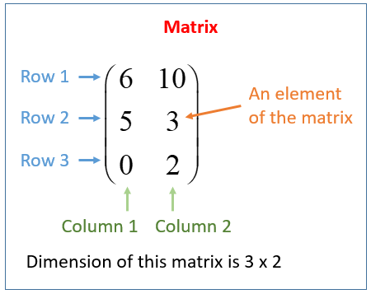
Matrix
A matrix consists of a set of numbers arranged in rows and columns enclosed in brackets.
The following diagram shows the rows and columns
of a 3 by 2 matrix.

Slide 3

dimensions or order of a matrix
The dimensions or order of a matrix gives the number of rows followed by the number
of columns in a matrix. The order of a matrix with 3 rows and 2 columns is 3 × 2 or 3 by 2.
We usually denote a matrix by a capital letter.
C is a matrix of order 2 × 4 (read as ‘2 by 4’)

Slide 4


elements of the matrix
Each number in the array is called an entry or an element of the matrix. When we need to read out the
elements of an array, we read it out row by row.
Each element is defined by its position in the matrix.
In a matrix A, an element in row i and column j is represented by a_{ij}
Example:
a₁₁ (read as ‘a one one ’)= 2 (first row, first column)
a₁₂ (read as ‘a one two') = 4 (first row, second column)
a₁₃ = 5, a₂₁ = 7, a₂₂ = 8, a₂₃ = 9

Slide 5

Matrices have many uses in real life. One application would be to use matrices to represent a large amount
of data in a concise manner so that we can process the data in various ways more conveniently.
For example, the sales of different types of pre-packed food from 3 stalls during a given period of time
could be shown in the form of a table here:
This table can be represented as a matrix:
This matrix could then be added with another that represents the sales for a different period of time
to get the total for the two periods of time, etc.
 | Stall A | Stall B | Stall C
Packs of noodles sold | 36 | 21 | 43
Packs of rice sold | 27 | 56 | 35

Slide 6
Types of Matrices
Row Matrix
A matrix having only one row is called a row matrix.
Thus A = [a_{ij}]_{mxn} is a row matrix if m = 1.
So, a row matrix can be represented as A = [a_{ij}]_{1×n}.
It is called so because it has only one row and the order of a row matrix will hence be 1 × n.
For example, A = [1 2 4 5] is row matrix of order 1 x 4.
Another example of the row matrix is P = [ -4 -21 -17 ] which is of the order 1×3.

Slide 7
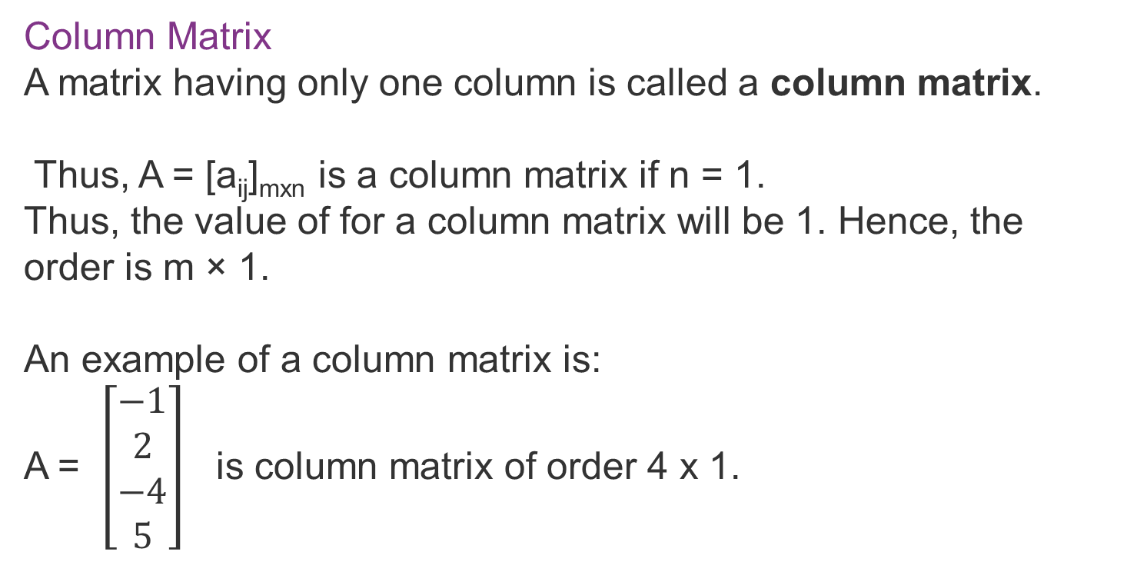
Column Matrix
A matrix having only one column is called a column matrix.
Thus, A = [a_{ij}]_{mxn} is a column matrix if n = 1.
Thus, the value of for a column matrix will be 1. Hence, the order is m × 1.
An example of a column matrix is:
A = $\left[\begin{aligned}−1 \\ 2 \\ −4 \\ 5\end{aligned}\right]$ is column matrix of order 4 x 1.

Slide 8
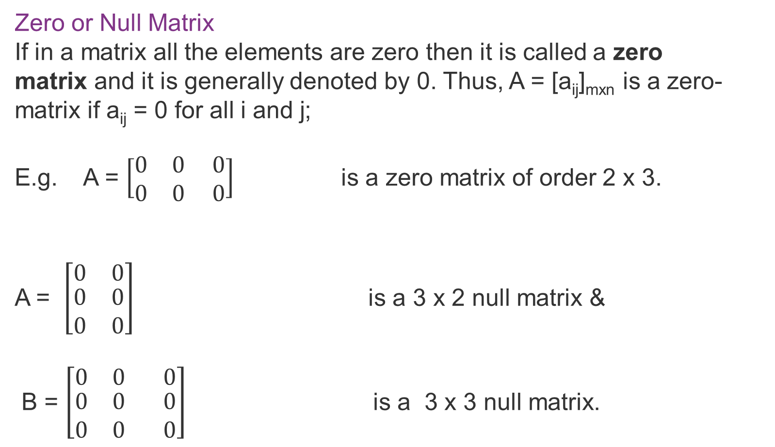
Zero or Null Matrix
If in a matrix all the elements are zero then it is called a zero matrix and it is generally denoted by 0. Thus, A = [a_{ij}]_{mxn} is a zero-matrix if a_{ij} = 0 for all i and j;
E.g. A = $\left[\begin{matrix}0 & 0 0 \\ 0 & 0 0\end{matrix}\right]$ is a zero matrix of order 2 x 3.
A = $\left[\begin{matrix}0 & 0 \\ \begin{aligned}0 \\ 0\end{aligned} & \begin{aligned}0 \\ 0\end{aligned}\end{matrix}\right]$ is a 3 x 2 null matrix &
B = $\left[\begin{matrix}0 & 0 0 \\ \begin{aligned}0 \\ 0\end{aligned} & \begin{aligned}0 0 \\ 0 0\end{aligned}\end{matrix}\right]$ is a 3 x 3 null matrix.

Slide 9
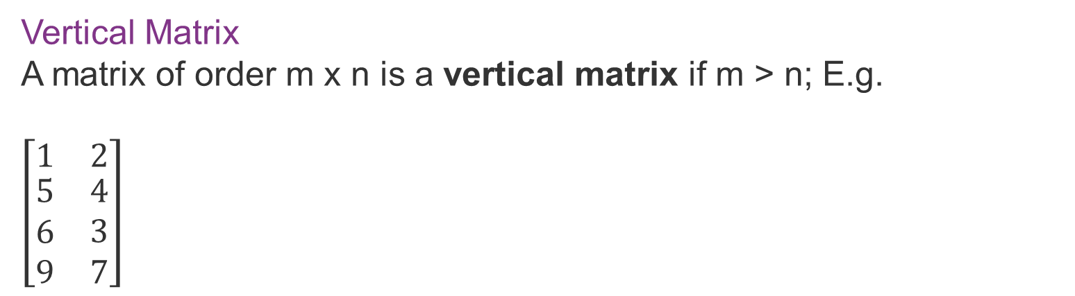

Singleton Matrix
If in a matrix there is only element then it is called singleton matrix. Thus, A = [a_{ij}]_{mxn} is a singleton matrix if m = n = 1. E.g. [2], [3], [a], [ ] are singleton matrices.
Horizontal Matrix
A matrix of order m x n is a horizontal matrix if n > m; E.g.
$$\left[\begin{matrix}1 & 2 3 4 \\ 5 & 2 2 1\end{matrix}\right]$$
Vertical Matrix
A matrix of order m x n is a vertical matrix if m > n; E.g.
$\left[\begin{matrix}1 & 2 \\ \begin{aligned}5 \\ 6 \\ 9\end{aligned} & \begin{aligned}4 \\ 3 \\ 7\end{aligned}\end{matrix}\right]$

Slide 10
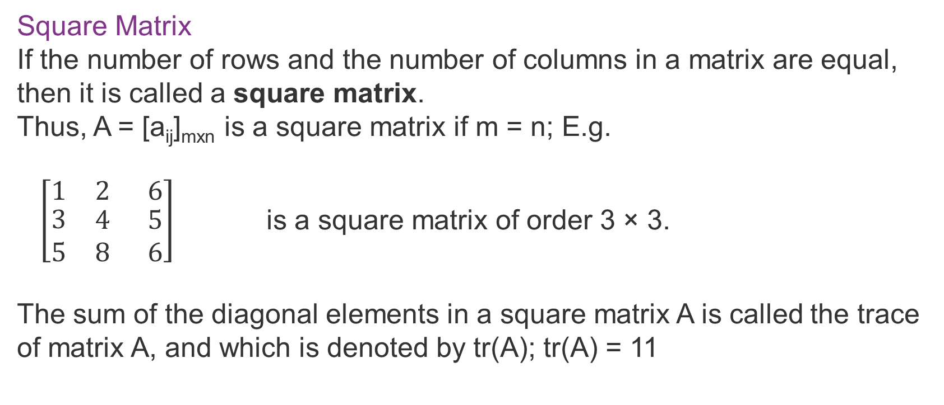
Square Matrix
If the number of rows and the number of columns in a matrix are equal, then it is called a square matrix.
Thus, A = [a_{ij}]_{mxn} is a square matrix if m = n; E.g.
$\left[\begin{matrix}1 & 2 6 \\ \begin{aligned}3 \\ 5\end{aligned} & \begin{aligned}4 5 \\ 8 6\end{aligned}\end{matrix}\right]$ is a square matrix of order 3 × 3.
The sum of the diagonal elements in a square matrix A is called the trace of matrix A, and which is denoted by tr(A); tr(A) = 11

Slide 11
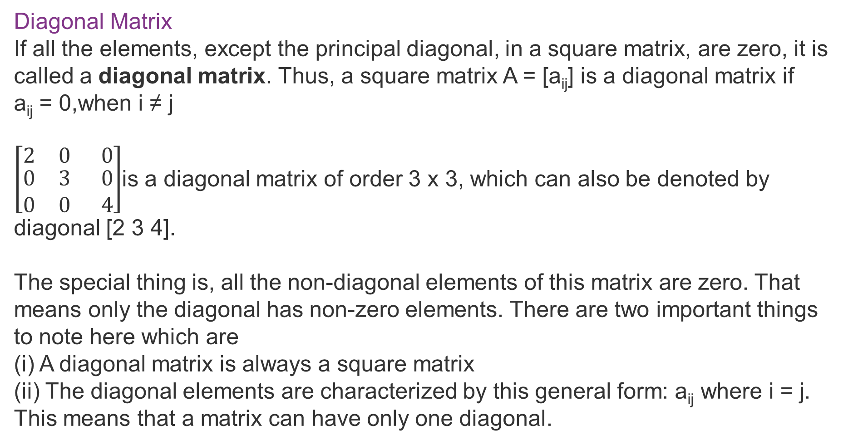
Diagonal Matrix
If all the elements, except the principal diagonal, in a square matrix, are zero, it is called a diagonal matrix. Thus, a square matrix A = [a_{ij}] is a diagonal matrix if a_{ij} = 0,when i ≠ j
$\left[\begin{matrix}2 & 0 0 \\ \begin{aligned}0 \\ 0\end{aligned} & \begin{aligned}3 0 \\ 0 4\end{aligned}\end{matrix}\right]$is a diagonal matrix of order 3 x 3, which can also be denoted by diagonal [2 3 4].
The special thing is, all the non-diagonal elements of this matrix are zero. That means only the diagonal has non-zero elements. There are two important things to note here which are
(i) A diagonal matrix is always a square matrix
(ii) The diagonal elements are characterized by this general form: a_{ij} where i = j. This means that a matrix can have only one diagonal.

Slide 12
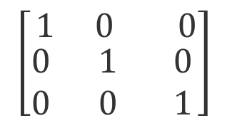
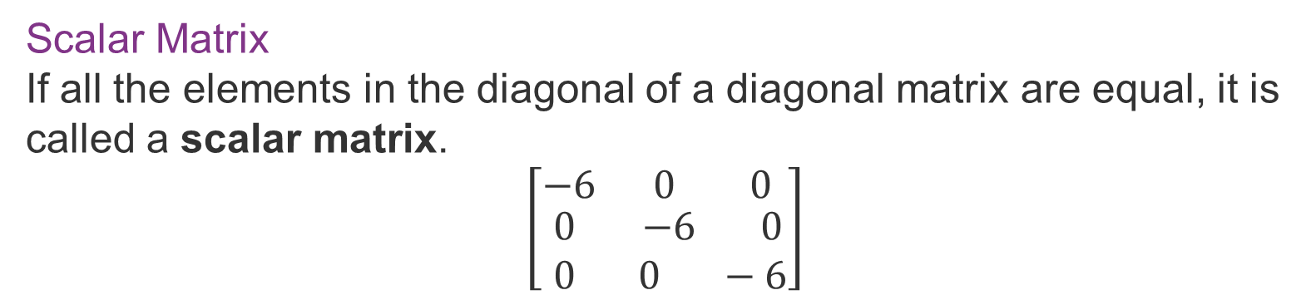
Scalar Matrix
If all the elements in the diagonal of a diagonal matrix are equal, it is called a scalar matrix.
$$\left[\begin{matrix}−6 & 0 0 \\ \begin{aligned}0 \\ 0\end{aligned} & \begin{aligned}−6 0 \\ 0 −6\end{aligned}\end{matrix}\right]$$
Unit Matrix or Identity Matrix
If all the elements of a principal diagonal in a diagonal matrix are 1, then it is called a unit matrix.
$$\left[\begin{matrix}1 & 0 0 \\ \begin{aligned}0 \\ 0\end{aligned} & \begin{aligned}1 0 \\ 0 1\end{aligned}\end{matrix}\right]$$

Slide 13




Equal Matrices
Two matrices A and B are said to be equal if they are of the same order and their corresponding elements are equal, i.e. Two matrices A = [a_{ij}]_{m×n} and B = [b_{ij}]_{r×s} are equal if:
(a) m = r i.e. the number of rows in A = the number of rows in B.
(b) n = s, i.e. the number of columns in A = the number of columns in B
(c) a_{ij} = b_{ij}, for i = 1, 2, ….., m and j = 1, 2, ….., n, i.e. the corresponding elements are equal;
For example, are not equal because their
orders are not the same.
But, If A = B A = B =
a = 1, b = 6, c = 3, d = 5, e = 2, f = 1.
$$\left[\begin{matrix}1 & 0 0 \\ \begin{aligned}0 \\ 0\end{aligned} & \begin{aligned}1 0 \\ 0 1\end{aligned}\end{matrix}\right]$$
$$\left[\begin{matrix}1 & 0 0 \\ 2 & 3 4\end{matrix}\right]$$
$$\left[\begin{matrix}1 & 6 3 \\ 5 & 2 1\end{matrix}\right]$$
$$\left[\begin{matrix}a & b c \\ d & e f\end{matrix}\right]$$

Slide 14


Triangular Matrix
A square matrix is said to be a triangular matrix if the elements above or below the principal diagonal are zero. There are two types:
Upper Triangular Matrix
A square matrix [a_{ij}] is called an upper triangular matrix, if a_{ij} = 0, when i > j.
e.g is an upper triangular matrix of order 3 x 3.
Lower Triangular Matrix
A square matrix is called a lower triangular matrix, if a_{ij} = 0 when i < j.
e.g. is a lower triangular matrix of order 3 x 3.
$$\left[\begin{matrix}1 & 2 3 \\ \begin{aligned}0 \\ 0\end{aligned} & \begin{aligned}4 5 \\ 0 0\end{aligned}\end{matrix}\right]$$
$$\left[\begin{matrix}4 & 0 0 \\ \begin{aligned}7 \\ 8\end{aligned} & \begin{aligned}5 0 \\ 6 1\end{aligned}\end{matrix}\right]$$

Slide 15
Singular Matrix and Non-Singular Matrix
Matrix A is said to be a singular matrix if its determinant |A| = 0, otherwise a non-singular matrix, i.e. If for det |A| = 0, it is singular matrix and for det |A| ≠ 0, it is non-singular.

Slide 16


Symmetric and Skew Symmetric Matrices
Symmetric matrix: A square matrix A = [a_{ij}] is called a symmetric matrix if a_{ij} = a_{ji}, for all i,j values;
Eg. A=
Note: A is symmetric if A’ = A (where ‘A’ is the transpose of matrix)
Skew-Symmetric Matrix: A square matrix A = [a_{ij}] is a skew-symmetric matrix if a_{ij} = a_{ji}, for all values of i,j and a_{ii} = 0
Thus, in a skew-symmetric matrix all diagonal elements are zero;
E.g. A =
is skew-symmetric matrix.
$\left[\begin{matrix}7 & 2 3 \\ \begin{aligned}2 \\ 3\end{aligned} & \begin{aligned}4 5 \\ 5 1\end{aligned}\end{matrix}\right]$
$\left[\begin{matrix}0 & 2 3 \\ \begin{aligned}2 \\ 3\end{aligned} & \begin{aligned}0 5 \\ 5 0\end{aligned}\end{matrix}\right]$

Slide 17
MCQ 1
If |A| = 0 then A is
(i) Zero matrix
(ii) Singular matrix
(iii) Non singular matric
(iv) Symmetric matrix
Answer: ii

Slide 18
MCQ 2
Horizantally arranged elements in a matrix is called:
(i) columns
(ii) rows
(iii) determinants
(iv) transpose
Answer: iii

Slide 19
MCQ 3
A matrix having m rows and n columns with m ≠ n is called
(i) Rectangular matrix
(ii) Square matrix
(iii) Identity matrix
(iv) Scalar matrix
Answer: i

Slide 20
MCQ 4
A square matrix in which all the elements except at least one diagonal element are zero is called
(i) Scalar matrix
(ii) Symmetric matrix
(iii) Diagonal matric
(iv) Column matrix
Answer: iii

Slide 21
MCQ 5
If All diagonal elements of a square matrix are 1 and rest are 0 then it is called
(i) Zero matrix
(ii) Identity matrix
(iii) Singular matrix
(iv) None of these
Answer: i

Slide 22
Operations on Matrices
Addition, subtraction and multiplication are the basic operations on the matrix. To add or subtract matrices, these must be of identical order and for multiplication, the number of columns in the first matrix equals the number of rows in the second matrix.
Addition of Matrices
Subtraction of Matrices
Scalar Multiplication of Matrices
Multiplication of Matrices

Slide 23

Matrix addition and subtraction
Matrix addition is the operation of adding two or matrices by adding the
corresponding entry of each matrix together.
The most important rule to know is that when adding two or more matrices, first make sure the matrices have the same dimensions. In order words, you can add a 2 x 3 with a 2 x 3 or a 2 x 2 with a 2 x 2. However, you cannot add a 3 x 2 with a 2 x 3 or a 2 x 2 with a 3 x 3.

Slide 24
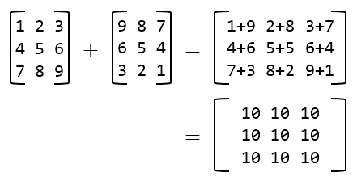

Slide 25
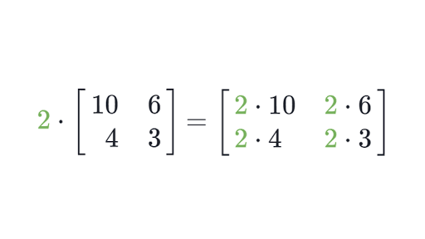
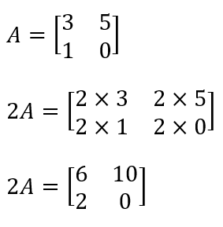
Scalar Multiplication of the matrix
Scalar Matrix Multiplication, in which a single real number is multiplied with every other element of the matrix

Slide 26
Product of two Matrix
The product of two matrices A and B is defined if the number of columns of A is equal to the number of rows of B. Let A = [aij] be an m × n matrix and B = [bjk] be an n × p matrix. Then the product of the matrices A and B is the matrix C of order m × p. To get the (i, k)th element c of the matrix C, we take the ith row of A and kth column of B, multiply them element-wise and take the sum of all these products.
In matrix multiplication, it is not necessary that both matrices must be a square matrix, as in addition and subtraction.

Slide 27

Suppose we have two matrices A and B of dimensions 2×3 and 3×2, respectively.
The resultant matrix will be a 2×2 matrix.
To find the first element of the resultant matrix, multiply the first row of matrix A
by the first column of matrix B and sum up the product.
(a,b,c).(p,q,r)=a×p+b×q+c×r
To find the second element of the resultant matrix, multiply the first row
of matrix A by the second column of matrix B and sum up the product.
(a,b,c).(x,y,z)=a×x+b×y+c×z

Slide 28
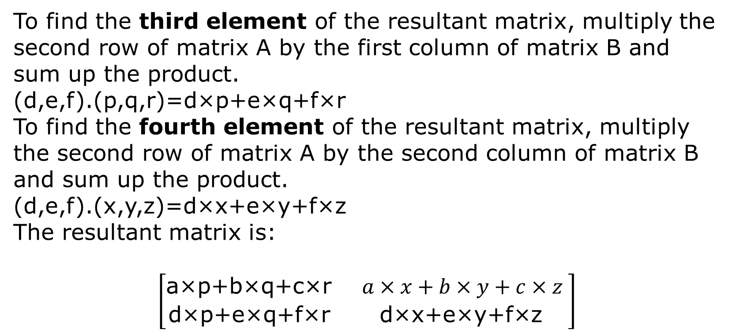
To find the third element of the resultant matrix, multiply the second row of matrix A by the first column of matrix B and sum up the product.
(d,e,f).(p,q,r)=d×p+e×q+f×r
To find the fourth element of the resultant matrix, multiply the second row of matrix A by the second column of matrix B and sum up the product.
(d,e,f).(x,y,z)=d×x+e×y+f×z
The resultant matrix is:
$$\left[\begin{matrix}\text{a}\text{×}\text{p}\text{+}\text{b}\text{×}\text{q}\text{+}\text{c}\text{×}\text{r} & a×x+b×y+c×z \\ \text{d}\text{×}\text{p}\text{+}\text{e}\text{×}\text{q}\text{+}\text{f}\text{×}\text{r} & \text{d}\text{×}\text{x}\text{+}\text{e}\text{×}\text{y}\text{+}\text{f}\text{×}\text{z} \end{matrix}\right]$$

Slide 29
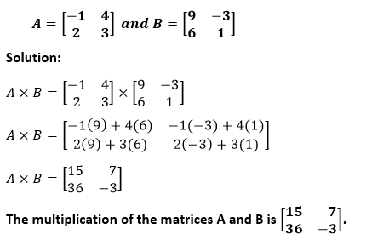
Example: Multiply the following matrices.

Slide 30


Solution:
The dimensions of the matrix A and B are 1×4 and 4×1, respectively,
the resultant matrix will be of dimension 1×1.
A×B=[2×7+5×2+6×3+8×9]
A×B=[114]
The multiplication of the matrices A and B is [114].

Slide 31
MCQ 1
Two matrices A and B can be multiplied if
(i) Both are rectangular
(ii) Both have same order
(iii) Number of columns of A is equal to number of rows of B
(iv) Number of rows of A is equal to number of columns of B
Answer: iii

Slide 32
MCQ 2
Two matrices A and B are added if
(i) Both are rectangular
(ii) Both have same order
(iii) Number of columns of A is equal to number of columns of B
(iv) Number of rows of A is equal to number of rows of B
Answer: ii

Slide 33
MCQ 3
If A and B are matrices the which of the following is true:
(i) AB ≠ BA
(ii) (A’)’ ≠ A
(iii) A + B ≠ B + A
(iv) All are true
Answer: i

Slide 34

MCQ 4
If $2\left[\begin{matrix}3 & 4 \\ 5 & x\end{matrix}\right]+ \left[\begin{matrix}1 & y \\ 0 & 1\end{matrix}\right]$ = $\left[\begin{matrix}7 & 0 \\ 10 & 5\end{matrix}\right]$, the find x and y
(i) 8
(ii) 10
(iii) 7
(iv) 12
Answer: ii

Slide 35
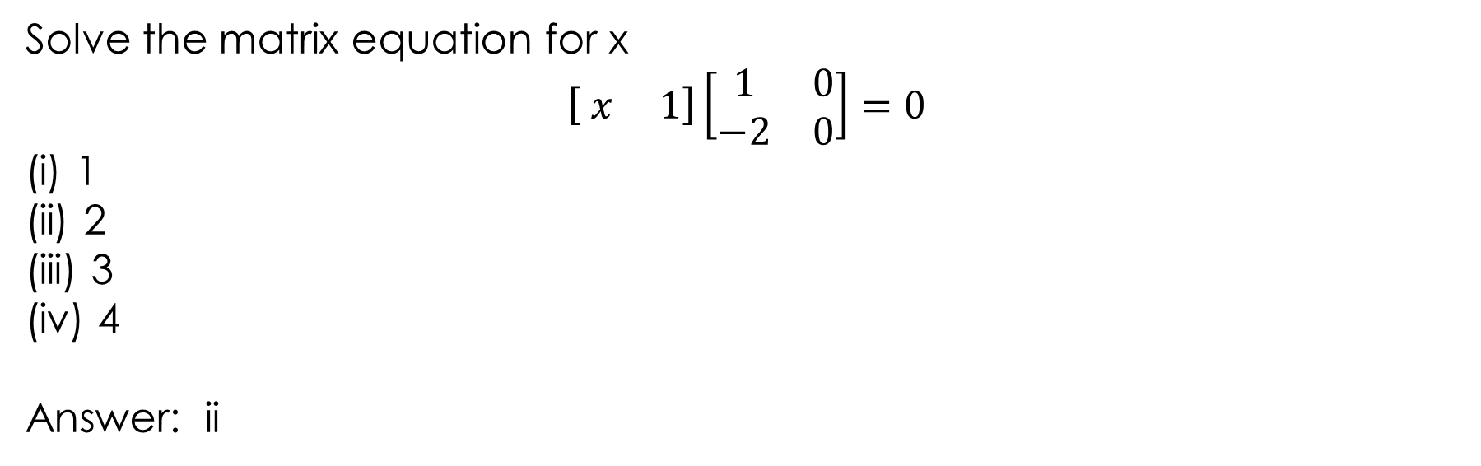
MCQ 5
Solve the matrix equation for x
$$\left[ x 1\right]\left[\begin{matrix}1 & 0 \\ −2 & 0\end{matrix}\right]=0$$
(i) 1
(ii) 2
(iii) 3
(iv) 4
Answer: ii

Slide 36
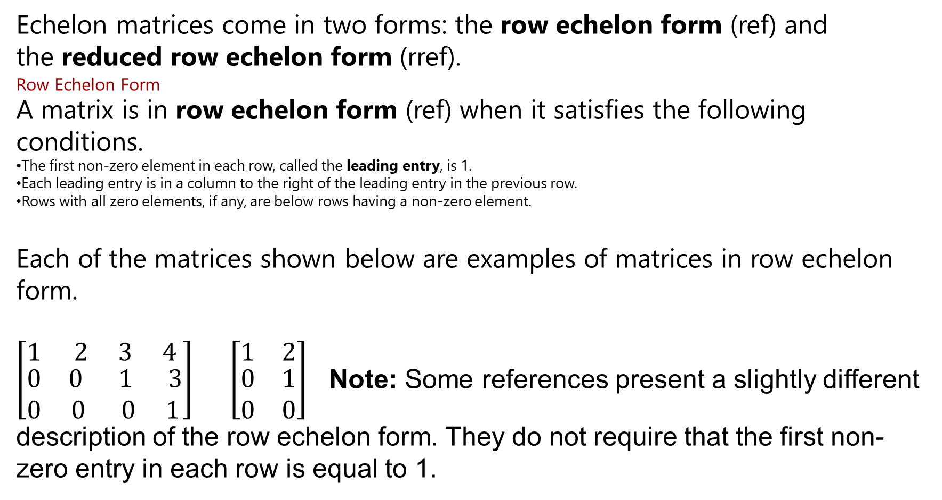
Echelon Form of a Matrix
Echelon matrices come in two forms: the row echelon form (ref) and the reduced row echelon form (rref).
Row Echelon Form
A matrix is in row echelon form (ref) when it satisfies the following conditions.
The first non-zero element in each row, called the leading entry, is 1.
Each leading entry is in a column to the right of the leading entry in the previous row.
Rows with all zero elements, if any, are below rows having a non-zero element.
Each of the matrices shown below are examples of matrices in row echelon form.
$\left[\begin{matrix}1 & 2 3 4 \\ \begin{aligned}0 \\ 0\end{aligned} & \begin{aligned}0 1 3 \\ 0 0 1\end{aligned}\end{matrix}\right]$ $\left[\begin{matrix}1 & 2 \\ \begin{aligned}0 \\ 0\end{aligned} & \begin{aligned}1 \\ 0\end{aligned}\end{matrix}\right]$ Note: Some references present a slightly different description of the row echelon form. They do not require that the first non-zero entry in each row is equal to 1.

Slide 37
Elementary Matrix Operations
Elementary matrix operations play an important role in many matrix algebra applications, such as finding the inverse of a matrix and solving simultaneous linear equations.
Elementary Operations
There are three kinds of elementary matrix operations.
Interchange two rows (or columns).
Multiply each element in a row (or column) by a non-zero number.
Multiply a row (or column) by a non-zero number and add the result to another row (or column).
When these operations are performed on rows, they are called elementary row operations; and when they are performed on columns, they are called elementary column operations.

Slide 38
Elementary Operation Notation
In many references, you will encounter a compact notation to describe elementary operations. That notation is shown below.
Operation description | Notation
Row operations
1. Interchange rows i and j | R_{i} <--> R_{j}
2. Multiply row i by s, where s ≠ 0 | sR_{i} --> R_{i}
3. Add s times row i to row j | sR_{i} + R_{j} --> R_{j}
Column operations
1. Interchange columns i and j | C_{i} <--> C_{j}
2. Multiply column i by s, where s ≠ 0 | sC_{i} --> C_{i}
3. Add s times column i to column j | sC_{i} + C_{j} --> C_{j}

Slide 39
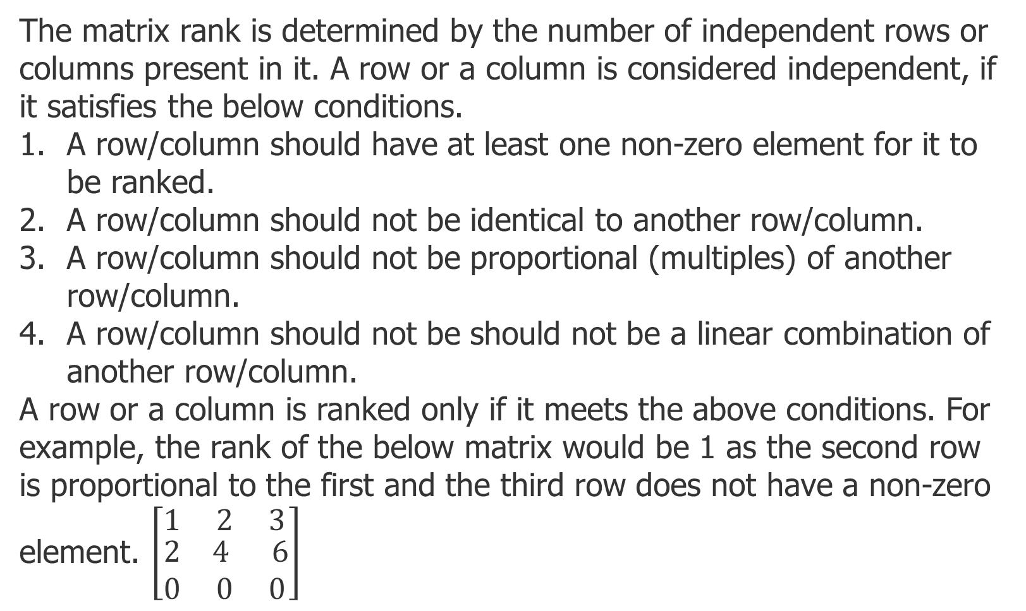
Rank of Matrix:
The matrix rank is determined by the number of independent rows or columns present in it. A row or a column is considered independent, if it satisfies the below conditions.
A row/column should have at least one non-zero element for it to be ranked.
A row/column should not be identical to another row/column.
A row/column should not be proportional (multiples) of another row/column.
A row/column should not be should not be a linear combination of another row/column.
A row or a column is ranked only if it meets the above conditions. For example, the rank of the below matrix would be 1 as the second row is proportional to the first and the third row does not have a non-zero element. $\left[\begin{matrix}1 & 2 3 \\ \begin{aligned}2 \\ 0\end{aligned} & \begin{aligned}4 6 \\ 0 0\end{aligned}\end{matrix}\right]$

Slide 40
How to calculate the rank of a matrix:
It can be calculated using various methods. We will calculate the rank based on Gaussian elimination method. Gaussian elimination method is used to calculate the matrix rank by converting it into the reduced row echelon form. It can be called as reduced row echelon form, if it satisfies the following conditions.
The first element in the first row should be the leading element i.e. 1.
The leading element in the columns should be to the right of the previous row's leading element.
If there are any rows with all zero elements, it should be below the non-zero element rows.
4. The leading element should be the only non-zero element in every column.

Slide 41
If we follow the above steps, then the matrix would become a triangular one, i.e. the elements below or above the main diagonal would become zero. Main diagonal, of a square matrix, is a diagonal which runs from top left corner and to the bottom right corner. However, in this session, we will not consider the last (fourth) point as it would not affect the rank of a matrix. A matrix can be converted to reduced row echelon form by using elementary operations. There are three basic elementary operations explained.
1.Interchanging two rows (or columns).
2.Multiplying a row (or a column) with a non-zero number.
3.Multiplying a row (or a column) with a non-zero number and adding the result to another row (or a column).

Slide 42
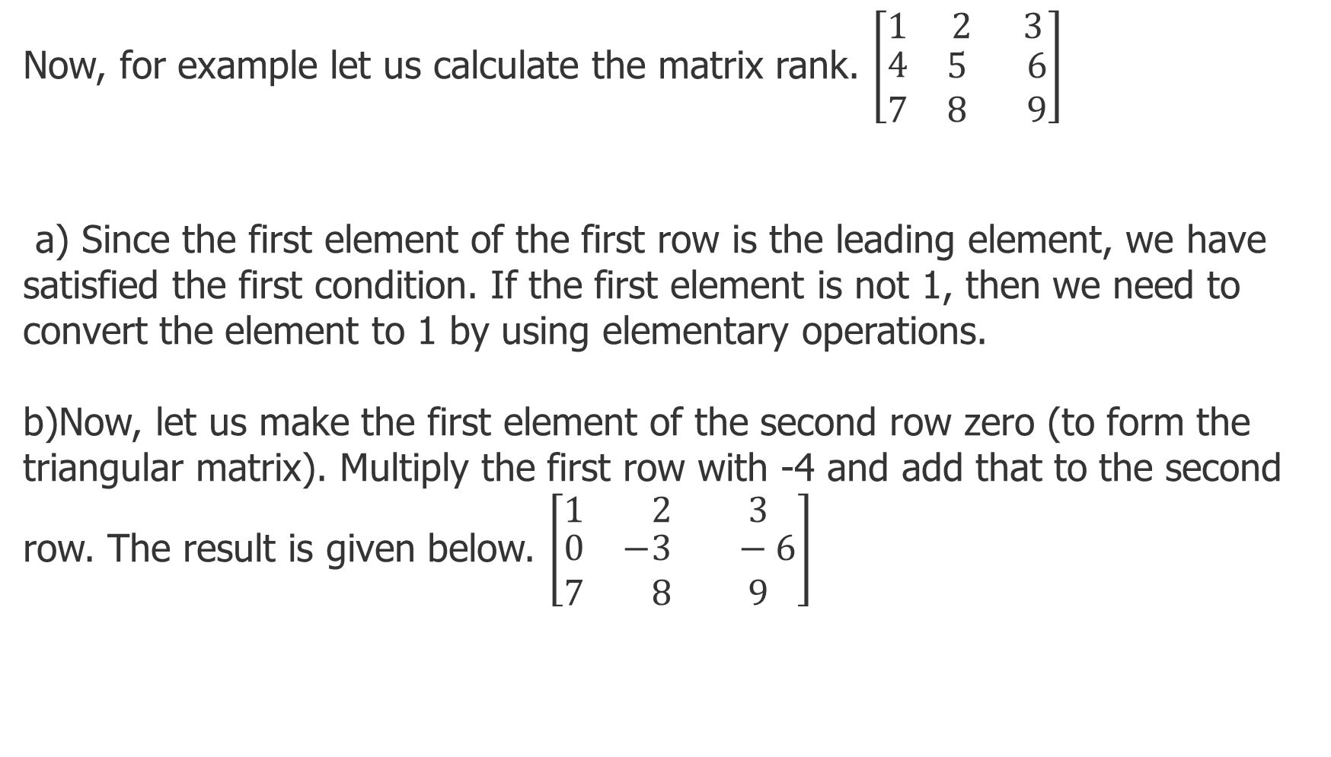
Now, for example let us calculate the matrix rank. $\left[\begin{matrix}1 & 2 3 \\ \begin{aligned}4 \\ 7\end{aligned} & \begin{aligned}5 6 \\ 8 9\end{aligned}\end{matrix}\right]$
a) Since the first element of the first row is the leading element, we have satisfied the first condition. If the first element is not 1, then we need to convert the element to 1 by using elementary operations.
b)Now, let us make the first element of the second row zero (to form the triangular matrix). Multiply the first row with -4 and add that to the second row. The result is given below. $\left[\begin{matrix}1 & 2 3 \\ \begin{aligned}0 \\ 7\end{aligned} & \begin{aligned}−3 −6 \\ 8 9\end{aligned}\end{matrix}\right]$

Slide 43
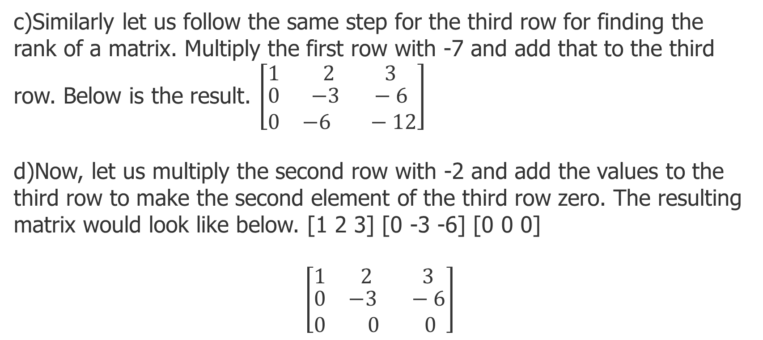
c)Similarly let us follow the same step for the third row for finding the rank of a matrix. Multiply the first row with -7 and add that to the third row. Below is the result. $\left[\begin{matrix}1 & 2 3 \\ \begin{aligned}0 \\ 0\end{aligned} & \begin{aligned}−3 −6 \\ −6 −12\end{aligned}\end{matrix}\right]$
d)Now, let us multiply the second row with -2 and add the values to the third row to make the second element of the third row zero. The resulting matrix would look like below. [1 2 3] [0 -3 -6] [0 0 0]
$$\left[\begin{matrix}1 & 2 3 \\ \begin{aligned}0 \\ 0\end{aligned} & \begin{aligned}−3 −6 \\ 0 0\end{aligned}\end{matrix}\right]$$

Slide 44
Now, since it has been converted to row echelon form, we can find the rank of matrix. The matrix rank is 2 as the third row has zero for all the elements. Therefor, the rank can be found in simple steps using Gaussian Elimination method.

Slide 45
MCQ 1
The number of non zero rows in an echelon form is called:
(i) Rank of a matrix
(ii) Cofactor of a matrix
(iii) Reduced echelon form
(iv) Conjugate of the matrix
Answer: i

Slide 46
MCQ 2
The rank of an mxn matrix is 2. Which among the following is true:
Number of non zero rows is exactly 2
Number of zero rows is exactly 2
Number of non zero rows is greater than 2
(iv) Number of zero rows is greater than 2
Answer: i

Slide 47
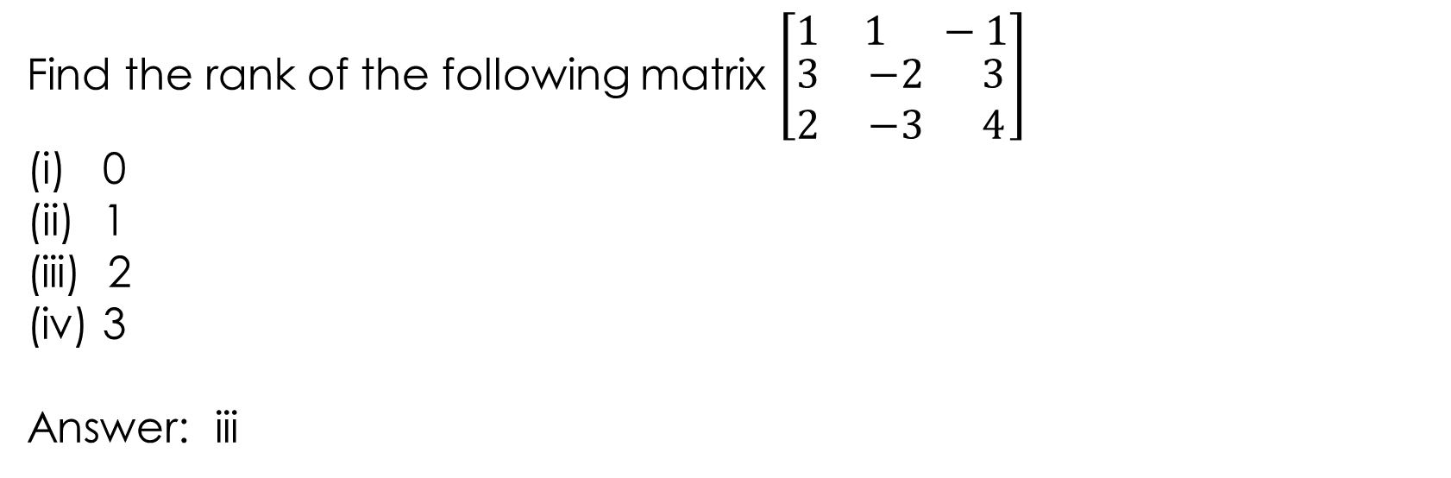
MCQ 3
Find the rank of the following matrix $\left[\begin{matrix}1 & 1 −1 \\ \begin{aligned}3 \\ 2\end{aligned} & \begin{aligned}−2 3 \\ −3 4\end{aligned}\end{matrix}\right]$
0
1
(iii) 2
(iv) 3
Answer: iii

Slide 48

MCQ 4
Find the rank $\left[\begin{matrix}4 & 3 6 25 \\ \begin{aligned}1 \\ 2\end{aligned} & \begin{aligned}5 7 13 \\ 9 1 1\end{aligned}\end{matrix}\right]$
(i) 0
(ii) 1
(iii) 2
(iv) 3
Answer: iii

Slide 49
MCQ 5
In row echelon form, which of the following is true:
(i) First element of every non zero row is 1
(ii) The row which is having every element zero should be below the non zero row.
(iii) Number of zeroes in the next non zero row should be more than the number of zeroes in the previous non zero row.
(iv) All of them
Answer: iv

